Slide 1
William Stallings
Data and Computer Communications
7th Edition
Chapter 14
Cellular Wireless Networks

Slide 2
Principles of Cellular Networks
Underlying technology for mobile phones, personal communication systems, wireless networking etc.
Developed for mobile radio telephone
  Replace high power transmitter/receiver systems
    Typical support for 25 channels over 80km
  Use lower power, shorter range, more transmitters

Slide 3
Cellular Network Organization
Multiple low power transmitters
  100w or less
Area divided into cells
  Each with own antenna
  Each with own range of frequencies
  Served by base station
    Transmitter, receiver, control unit
  Adjacent cells on different frequencies to avoid crosstalk

Slide 4
Shape of Cells
Square
  Width d cell has four neighbors at distance d and four at distance d
  Better if all adjacent antennas equidistant
    Simplifies choosing and switching to new antenna
Hexagon
  Provides equidistant antennas
  Radius defined as radius of circum-circle
    Distance from center to vertex equals length of side
  Distance between centers of cells radius R is R
  Not always precise hexagons
    Topographical limitations
    Local signal propagation conditions
    Location of antennas

Slide 5
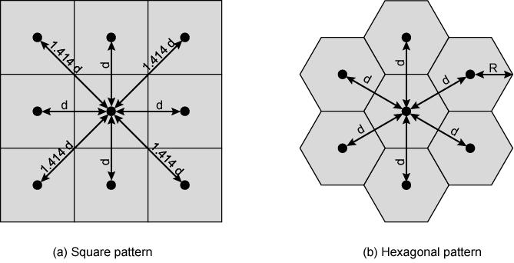
Cellular Geometries

Slide 6
Frequency Reuse
Power of base transceiver controlled
  Allow communications within cell on given frequency
  Limit escaping power to adjacent cells
  Allow re-use of frequencies in nearby cells
  Use same frequency for multiple conversations
  10 – 50 frequencies per cell
E.g.
  N cells all using same number of frequencies
  K total number of frequencies used in systems
  Each cell has K/N frequencies
  Advanced Mobile Phone Service (AMPS) K=395, N=7 giving 57 frequencies per cell on average

Slide 7
Characterizing Frequency Reuse
D = minimum distance between centers of cells that use the same band of frequencies (called cochannels)
R = radius of a cell
d = distance between centers of adjacent cells (d = R)
N = number of cells in repetitious pattern
  Reuse factor
  Each cell in pattern uses unique band of frequencies
Hexagonal cell pattern, following values of N possible
  N = I² + J² + (I x J), I, J = 0, 1, 2, 3, …
Possible values of N are 1, 3, 4, 7, 9, 12, 13, 16, 19, 21, …
D/R=
D/d =

Slide 8
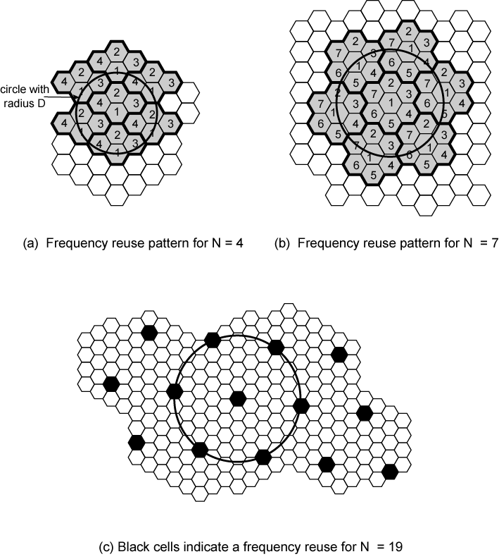
Frequency
Reuse
Patterns

Slide 9
Increasing Capacity (1)
Add new channels
  Not all channels used to start with
Frequency borrowing
  Taken from adjacent cells by congested cells
  Or assign frequencies dynamically
Cell splitting
  Non-uniform distribution of topography and traffic
  Smaller cells in high use areas
    Original cells 6.5 – 13 km
    1.5 km limit in general
    More frequent handoff
    More base stations

Slide 10
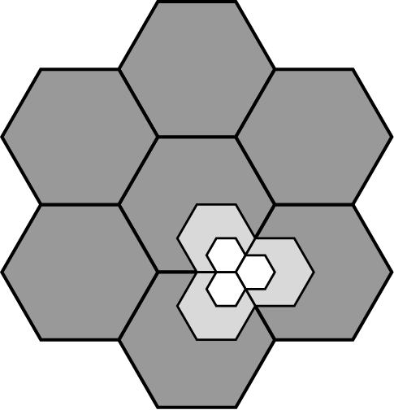
Cell Splitting

Slide 11
Increasing Capacity (2)
Cell Sectoring
  Cell divided into wedge shaped sectors
  3 – 6 sectors per cell
  Each with own channel set
    Subsets of cell’s channels
  Directional antennas
Microcells
  Move antennas from tops of hills and large buildings to tops of small buildings and sides of large buildings
    Even lamp posts
  Form microcells
  Reduced power
  Good for city streets, along roads and inside large buildings

Slide 12
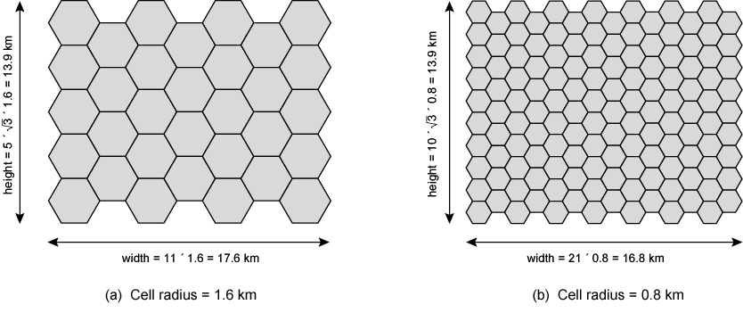
Frequency Reuse Example

Slide 13
Operation of Cellular Systems
Base station (BS) at center of each cell
  Antenna, controller, transceivers
Controller handles call process
  Number of mobile units may in use at a time
BS connected to mobile telecommunications switching office (MTSO)
  One MTSO serves multiple BS
  MTSO to BS link by wire or wireless
MTSO:
  Connects calls between mobile units and from mobile to fixed telecommunications network
  Assigns voice channel
  Performs handoffs
  Monitors calls (billing)
Fully automated

Slide 14
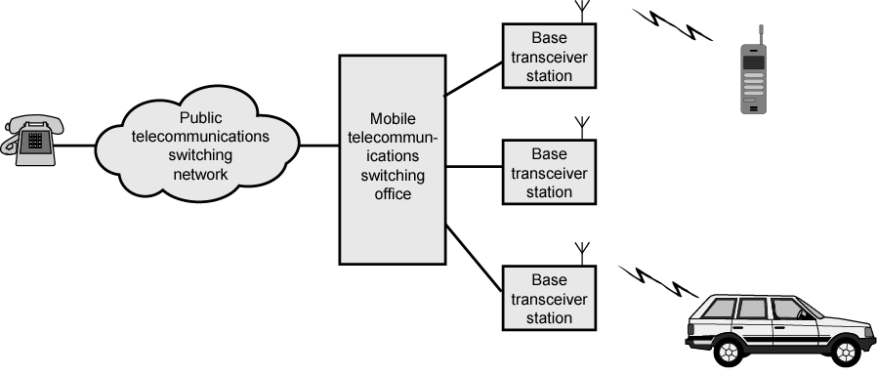
Overview of Cellular System

Slide 15
Channels
Control channels
  Setting up and maintaining calls
  Establish relationship between mobile unit and nearest BS
Traffic channels
  Carry voice and data

Slide 16
Typical Call in
Single MTSO Area (1)
Mobile unit initialization
  Scan and select strongest set up control channel
  Automatically selected BS antenna of cell
    Usually but not always nearest (propagation anomalies)
  Handshake to identify user and register location
  Scan repeated to allow for movement
    Change of cell
  Mobile unit monitors for pages (see below)
Mobile originated call
  Check set up channel is free
    Monitor forward channel (from BS) and wait for idle
  Send number on pre-selected channel
Paging
  MTSO attempts to connect to mobile unit
  Paging message sent to BSs depending on called mobile number
  Paging signal transmitted on set up channel

Slide 17
Typical Call in
Single MTSO Area (2)
Call accepted
  Mobile unit recognizes number on set up channel
  Responds to BS which sends response to MTSO
  MTSO sets up circuit between calling and called BSs
  MTSO selects available traffic channel within cells and notifies BSs
  BSs notify mobile unit of channel
Ongoing call
  Voice/data exchanged through respective BSs and MTSO
Handoff
  Mobile unit moves out of range of cell into range of another cell
  Traffic channel changes to one assigned to new BS
    Without interruption of service to user

Slide 18
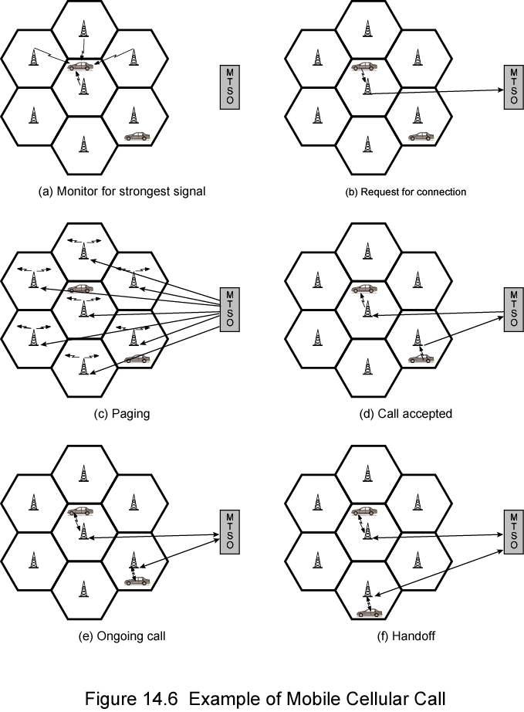
Call Stages

Slide 19
Other Functions
Call blocking
  During mobile-initiated call stage, if all traffic channels busy, mobile tries again
  After number of fails, busy tone returned
Call termination
  User hangs up
  MTSO informed
  Traffic channels at two BSs released
Call drop
  BS cannot maintain required signal strength
  Traffic channel dropped and MTSO informed
Calls to/from fixed and remote mobile subscriber
  MTSO connects to PSTN
  MTSO can connect mobile user and fixed subscriber via PSTN
  MTSO can connect to remote MTSO via PSTN or via dedicated lines
  Can connect mobile user in its area and remote mobile user

Slide 20
Mobile Radio
Propagation Effects
Signal strength
  Strength of signal between BS and mobile unit strong enough to maintain signal quality at the receiver
  Not strong enough to create too much cochannel interference
  Noise varies
    Automobile ignition noise greater in city than in suburbs
    Other signal sources vary
    Signal strength varies as function of distance from BS
    Signal strength varies dynamically as mobile unit moves
Fading
  Even if signal strength in effective range, signal propagation effects may disrupt the signal

Slide 21
Design Factors
Propagation effects
  Dynamic
  Hard to predict
Maximum transmit power level at BS and mobile units
Typical height of mobile unit antenna
Available height of the BS antenna
These factors determine size of individual cell
Model based on empirical data
Apply model to given environment to develop guidelines for cell size
E.g. model by Okumura et al refined by Hata
  Detailed analysis of Tokyo area
  Produced path loss information for an urban environment
  Hata's model is an empirical formulation
    Takes into account variety of environments and conditions

Slide 22
Fading
Time variation of received signal
Caused by changes in transmission path(s)
E.g. atmospheric conditions (rain)
Movement of (mobile unit) antenna

Slide 23
Multipath Propagation
Reflection
  Surface large relative to wavelength of signal
  May have phase shift from original
  May cancel out original or increase it
Diffraction
  Edge of impenetrable body that is large relative to wavelength
  May receive signal even if no line of sight (LOS) to transmitter
Scattering
  Obstacle size on order of wavelength
    Lamp posts etc.
If LOS, diffracted and scattered signals not significant
  Reflected signals may be
If no LOS, diffraction and scattering are primary means of reception

Slide 24
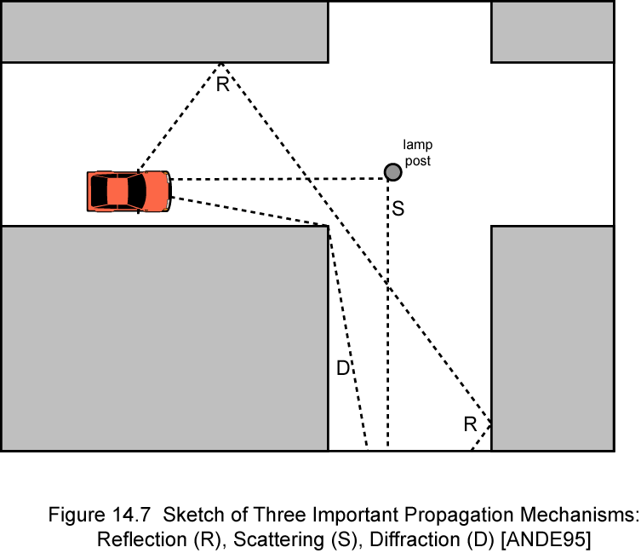
Reflection, Diffraction, Scattering

Slide 25
Effects of Multipath Propagation
Signals may cancel out due to phase differences
Intersymbol Interference (ISI)
  Sending narrow pulse at given frequency between fixed antenna and mobile unit
  Channel may deliver multiple copies at different times
  Delayed pulses act as noise making recovery of bit information difficult
  Timing changes as mobile unit moves
    Harder to design signal processing to filter out multipath effects

Slide 26
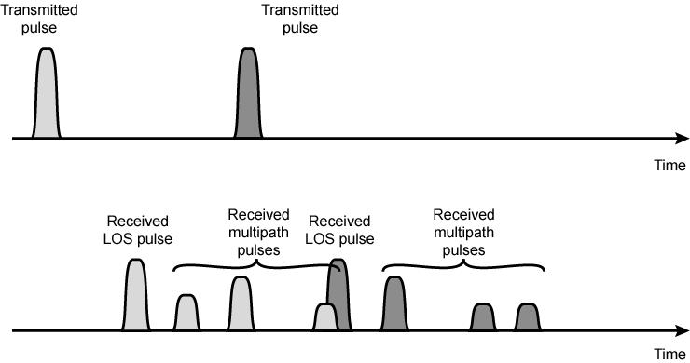
Two Pulses in Time-Variant Multipath

Slide 27
Types of Fading
Fast fading
  Rapid changes in strength over distances about half wavelength
    900MHz wavelength is 0.33m
    20-30dB
Slow fading
  Slower changes due to user passing different height buildings, gaps in buildings etc.
  Over longer distances than fast fading
Flat fading
  Nonselective
  Affects all frequencies in same proportion
Selective fading
  Different frequency components affected differently

Slide 28
Error Compensation Mechanisms (1)
Forward error correction
  Applicable in digital transmission applications
  Typically, ratio of total bits sent to data bits between 2 and 3
  Big overhead
    Capacity one-half or one-third
    Reflects difficulty or mobile wireless environment
Adaptive equalization
  Applied to transmissions that carry analog or digital information
  Used to combat intersymbol interference
  Gathering the dispersed symbol energy back together into its original time interval
  Techniques include so-called lumped analog circuits and sophisticated digital signal processing algorithms

Slide 29
Error Compensation Mechanisms (2)
Diversity
  Based on fact that individual channels experience independent fading events
  Provide multiple logical channels between transmitter and receiver
  Send part of signal over each channel
  Doesn’t eliminate errors
  Reduce error rate
  Equalization, forward error correction then cope with reduced error rate
  May involve physical transmission path
    Space diversity
    Multiple nearby antennas receive message or collocated multiple directional antennas
  More commonly, diversity refers to frequency or time diversity

Slide 30
Frequency Diversity
Signal is spread out over a larger frequency bandwidth or carried on multiple frequency carriers
E.g. spread spectrum (see chapter 9)

Slide 31
First Generation Analog
Original cellular telephone networks
Analog traffic channels
Early 1980s in North America
Advanced Mobile Phone Service (AMPS)
  AT&T
Also common in South America, Australia, and China

Slide 32
Spectral Allocation In North America
Two 25-MHz bands are allocated to AMPS
  One from BS to mobile unit (869–894 MHz)
  Other from mobile to base station (824–849 MHz)
Bands is split in two to encourage competition
  In each market two operators can be accommodated
Operator is allocated only 12.5 MHz in each direction
Channels spaced 30 kHz apart
  Total of 416 channels per operator
Twenty-one channels allocated for control
395 to carry calls
Control channels are 10 kbps data channels
Conversation channels carry analog using frequency modulation
Control information also sent on conversation channels in bursts as data
Number of channels inadequate for most major markets
For AMPS, frequency reuse is exploited

Slide 33
Operation
AMPS-capable phone has numeric assignment module (NAM) in read-only memory
  NAM contains number of phone
    Assigned by service provider
  Serial number of phone
    Assigned by the manufacturer
  When phone turned on, transmits serial number and phone number to MTSO (Figure 14.5)
  MTSO has database of mobile units reported stolen
    Uses serial number to lock out stolen units
  MTSO uses phone number for billing
  If phone is used in remote city, service is still billed to user's local service provider

Slide 34
Call Sequence
Subscriber initiates call by keying in number and presses send
MTSO validates telephone number and checks user authorized to place call
  Some service providers require a PIN to counter theft
MTSO issues message to user's phone indicating traffic channels to use
MTSO sends ringing signal to called party
  All operations, 2 through 4, occur within 10 s of initiating call
When called party answers, MTSO establishes circuit and initiates billing information
When one party hangs up MTSO releases circuit, frees radio channels, and completes billing information

Slide 35
AMPS Control Channels
21 full-duplex 30-kHz control channels
  Transmit digital data using FSK
  Data are transmitted in frames
Control information can be transmitted over voice channel during conversation
  Mobile unit or the base station inserts burst of data
    Turn off voice FM transmission for about 100 ms
    Replacing it with an FSK-encoded message
  Used to exchange urgent messages
    Change power level
    Handoff

Slide 36
Second Generation CDMA
Higher quality signals
Higher data rates
Support of digital services
Greater capacity
Digital traffic channels
  Support digital data
  Voice traffic digitized
  User traffic (data or digitized voice) converted to analog signal for transmission
Encryption
  Simple to encrypt digital traffic
Error detection and correction
  (See chapter 6)
  Very clear voice reception
Channel access
  Channel dynamically shared by users via Time division multiple access (TDMA) or code division multiple access (CDMA)

Slide 37
Code Division Multiple Access
Each cell allocated frequency bandwidth
  Split in two
    Half for reverse, half for forward
    Direct-sequence spread spectrum (DSSS) (see chapter 9)

Slide 38
Code Division Multiple Access
Advantages
Frequency diversity
  Frequency-dependent transmission impairments (noise bursts, selective fading) have less effect
Multipath resistance
  DSSS overcomes multipath fading by frequency diversity
  Also, chipping codes used only exhibit low cross correlation and low autocorrelation
  Version of signal delayed more than one chip interval does not interfere with the dominant signal as much
Privacy
  From spread spectrum (see chapter 9)
Graceful degradation
  With FDMA or TDMA, fixed number of users can access system simultaneously
  With CDMA, as more users access the system simultaneously, noise level and hence error rate increases
  Gradually system degrades

Slide 39
Code Division Multiple Access
Self-jamming
  Unless all mobile users are perfectly synchronized, arriving transmissions from multiple users will not be perfectly aligned on chip boundaries
  Spreading sequences of different users not orthogonal
  Some cross correlation
  Distinct from either TDMA or FDMA
    In which, for reasonable time or frequency guardbands, respectively, received signals are orthogonal or nearly so
Near-far problem
  Signals closer to receiver are received with less attenuation than signals farther away
  Given lack of complete orthogonality, transmissions from more remote mobile units may be more difficult to recover

Slide 40
RAKE Receiver
If multiple versions of signal arrive more than one chip interval apart, receiver can recover signal by correlating chip sequence with dominant incoming signal
  Remaining signals treated as noise
Better performance if receiver attempts to recover signals from multiple paths and combine them, with suitable delays
Original binary signal is spread by XOR operation with chipping code
Spread sequence modulated for transmission over wireless channel
Multipath effects generate multiple copies of signal
  Each with a different amount of time delay (τ1, τ2, etc.)
  Each with a different attenuation factors (a1, a2, etc.)
  Receiver demodulates combined signal
  Demodulated chip stream fed into multiple correlators, each delayed by different amount
  Signals combined using weighting factors estimated from the channel

Slide 41
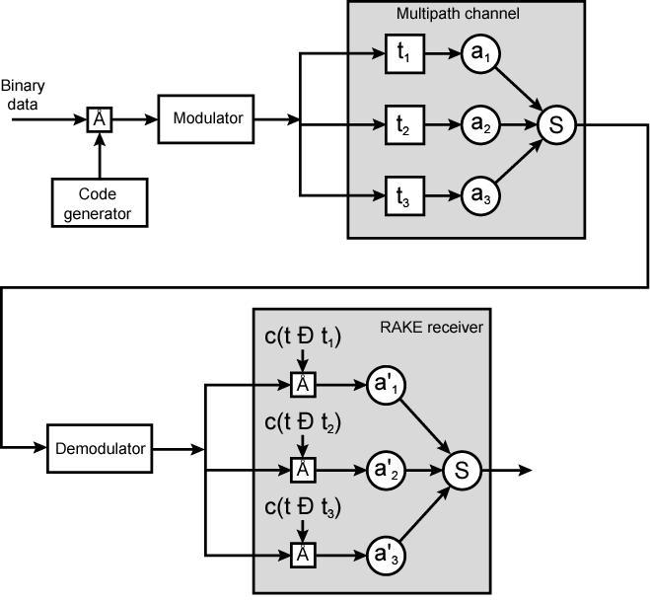
Principle of RAKE Receiver

Slide 42
IS-95
Second generation CDMA scheme
Primarily deployed in North America
Transmission structures different on forward and reverse links

Slide 43
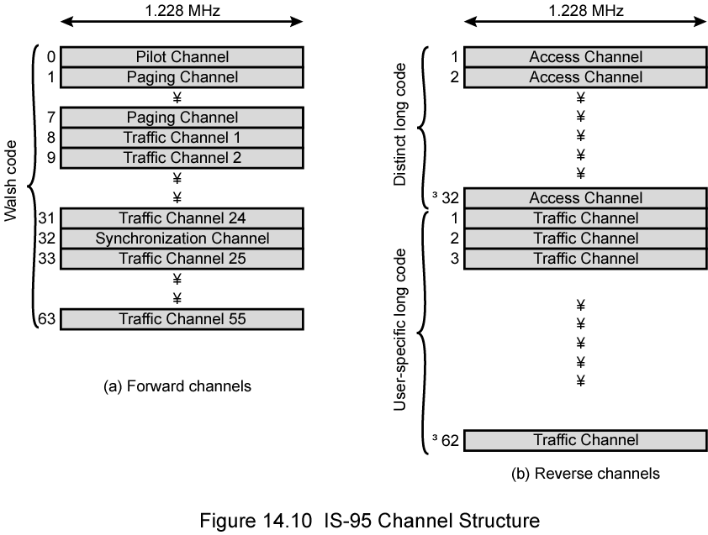
IS-95 Channel Structure

Slide 44
IS-95 Forward Link (1)
Up to 64 logical CDMA channels each occupying the same 1228-kHz bandwidth
Four types of channels:
  Pilot (channel 0)
    Continuous signal on a single channel
    Allows mobile unit to acquire timing information
    Provides phase reference for demodulation process
    Provides signal strength comparison for handoff determination
    Consists of all zeros
  Synchronization (channel 32)
    1200-bps channel used by mobile station to obtain identification information about the cellular system
    System time, long code state, protocol revision, etc.

Slide 45
IS-95 Forward Link (2)
  Paging (channels 1 to 7)
    Contain messages for one or more mobile stations
  Traffic (channels 8 to 31 and 33 to 63)
    55 traffic channels
    Original specification supported data rates of up to 9600 bps
    Revision added rates up to 14,400 bps
  All channels use same bandwidth
    Chipping code distinguishes among channels
    Chipping codes are the 64 orthogonal 64-bit codes derived from 64 × 64 Walsh matrix

Slide 46
Forward Link Processing
Voice traffic encoded at 8550 bps
Additional bits added for error detection
  Rate now 9600 bps
Full capacity not used when user not speaking
Quiet period data rate as low as 1200 bps
2400 bps rate used to transmit transients in background noise
4800 bps rate to mix digitized speech and signaling data
Data transmitted in 20 ms blocks
Forward error correction
  Convolutional encoder with rate ½
  Doubling effective data rate to 19.2 kbps
  For lower data rates encoder output bits (called code symbols) replicated to yield 19.2-kbps
Data interleaved in blocks to reduce effects of errors by spreading them

Slide 47
Scrambling
After interleaver, data scrambled
Privacy mask
Prevent sending of repetitive patterns
  Reduces probability of users sending at peak power at same time
Scrambling done by long code
  Pseudorandom number generated from 42-bit-long shift register
  Shift register initialized with user's electronic serial number
  Output of long code generator is at a rate of 1.2288 Mbps
    64 times 19.2 kbps
    One bit in 64 selected (by the decimator function)
    Resulting stream XORed with output of block interleaver

Slide 48
Power Control
Next step inserts power control information in traffic channel
  To control the power output of antenna
  Robs traffic channel of bits at rate of 800 bps by stealing code bits
  800-bps channel carries information directing mobile unit to change output level
  Power control stream multiplexed into 19.2 kbps
    Replace some code bits, using long code generator to encode bits

Slide 49
DSSS
Spreads 19.2 kbps to 1.2288 Mbps
Using one row of Walsh matrix
  Assigned to mobile station during call setup
  If 0 presented to XOR, 64 bits of assigned row sent
  If 1 presented, bitwise XOR of row sent
Final bit rate 1.2288 Mbps
Bit stream modulated onto carrier using QPSK
  Data split into I and Q (in-phase and quadrature) channels
  Data in each channel XORed with unique short code
    Pseudorandom numbers from 15-bit-long shift register

Slide 50
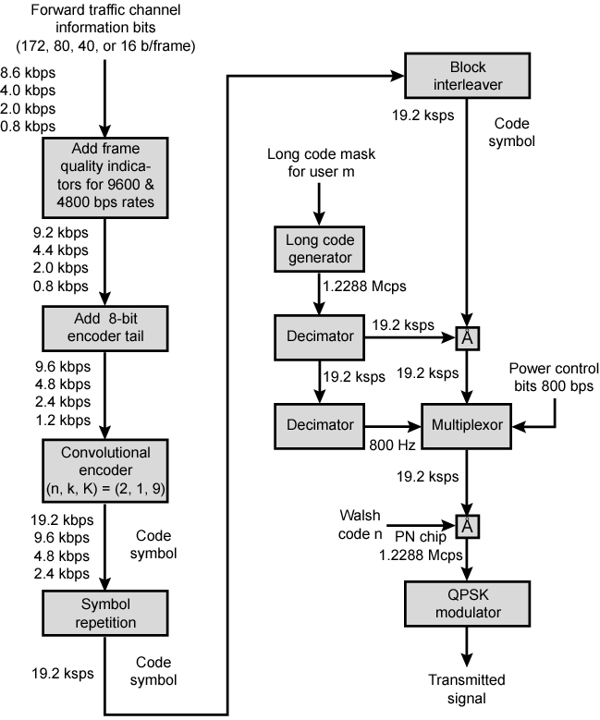
Forward
Link
Transmission

Slide 51
Reverse Link
Up to 94 logical CDMA channels
  Each occupying same 1228-kHz bandwidth
  Supports up to 32 access channels and 62 traffic channels
Traffic channels mobile unique
  Each station has unique long code mask based on serial number
    42-bit number, 2⁴² – 1 different masks
    Access channel used by mobile to initiate call, respond to paging channel message, and for location update

Slide 52
Reverse Link Processing and Spreading
First steps same as forward channel
  Convolutional encoder rate 1/3
  Tripling effective data rate to max. 28.8 kbps
  Data block interleaved
Spreading using Walsh matrix
  Use and purpose different from forward channel
  Data from block interleaver grouped in units of 6 bits
  Each 6-bit unit serves as index to select row of matrix (2⁶ = 64)
  Row is substituted for input
  Data rate expanded by factor of 64/6 to 307.2 kbps
  Done to improve reception at BS
  Because possible codings orthogonal, block coding enhances decision-making algorithm at receiver
  Also computationally efficient
  Walsh modulation form of block error-correcting code
  (n, k) = (64, 6) and d_{min} = 32
  In fact, all distances 32

Slide 53
Data Burst Randomizer
Reduce interference from other mobile stations
Using long code mask to smooth data out over 20 ms frame

Slide 54
DSSS
Long code unique to mobile XORed with output of randomizer
1.2288-Mbps final data stream
Modulated using orthogonal QPSK modulation scheme
Differs from forward channel in use of delay element in modulator to produce orthogonality
  Forward channel, spreading codes orthogonal
    Coming from Walsh matrix
  Reverse channel orthogonality of spreading codes not guaranteed

Slide 55
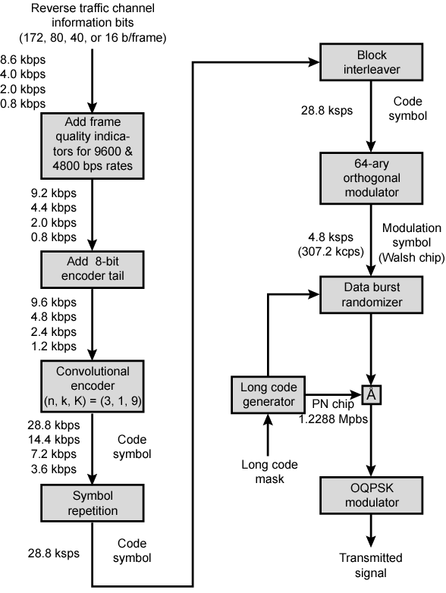
Reverse
Link
Transmission

Slide 56
Third Generation Systems
Objective to provide fairly high-speed wireless communications to support multimedia, data, and video in addition to voice
ITU’s International Mobile Telecommunications for the year 2000 (IMT-2000) initiative defined ITU’s view of third-generation capabilities as:
  Voice quality comparable to PSTN
  144 kbps available to users in vehicles over large areas
  384 kbps available to pedestrians over small areas
  Support for 2.048 Mbps for office use
  Symmetrical and asymmetrical data rates
  Support for packet-switched and circuit-switched services
  Adaptive interface to Internet
  More efficient use of available spectrum
  Support for variety of mobile equipment
  Flexibility to allow introduction of new services and technologies

Slide 57
Driving Forces
Trend toward universal personal telecommunications
  Ability of person to identify himself and use any communication system in globally, in terms of single account
Universal communications access
  Using one’s terminal in a wide variety of environments to connect to information services
  e.g. portable terminal that will work in office, street, and planes equally well
GSM cellular telephony with subscriber identity module, is step towards goals
Personal communications services (PCSs) and personal communication networks (PCNs) also form objectives for third-generation wireless
Technology is digital using time division multiple access or code-division multiple access
PCS handsets low power, small and light

Slide 58
Alternative Interfaces (1)
IMT-2000 specification covers set of radio interfaces for optimized performance in different radio environments
Five alternatives to enable smooth evolution from existing systems
Alternatives reflect evolution from second generation
Two specifications grow out of work at European Telecommunications Standards Institute (ETSI)
  Develop a UMTS (universal mobile telecommunications system) as Europe's 3G wireless standard
  Includes two standards
    Wideband CDMA, or W-CDMA
      Fully exploits CDMA technology
      Provides high data rates with efficient use of bandwidth
    IMT-TC, or TD-CDMA
      Combination of W-CDMA and TDMA technology
      Intended to provide upgrade path for TDMA-based GSM systems

Slide 59
Alternative Interfaces (2)
CDMA2000
  North American origin
  Similar to, but incompatible with, W-CDMA
    In part because standards use different chip rates
    Also, cdma2000 uses multicarrier, not used with W-CDMA
IMT-SC designed for TDMA-only networks
IMT-FC can be used by both TDMA and FDMA carriers
  To provide some 3G services
  Outgrowth of Digital European Cordless Telecommunications (DECT) standard

Slide 60
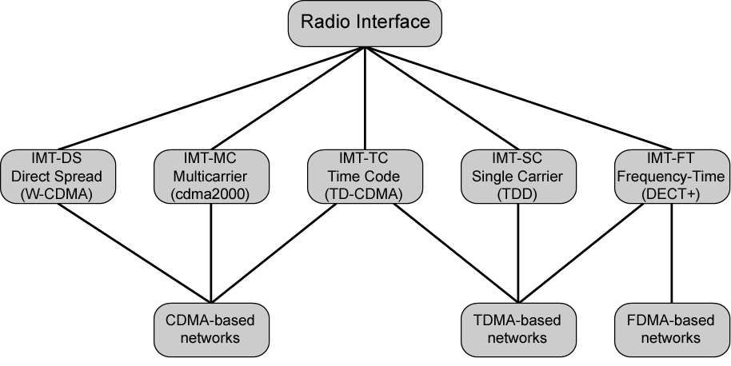
IMT-2000 Terrestrial Radio Interfaces

Slide 61
CDMA Design Considerations – Bandwidth and Chip Rate
Dominant technology for 3G systems is CDMA
  Three different CDMA schemes have been adopted
  Share some common design issues
Bandwidth
  Limit channel usage to 5 MHz
  Higher bandwidth improves the receiver's ability to resolve multipath
  But available spectrum is limited by competing needs
  5 MHz reasonable upper limit on what can be allocated for 3G
  5 MHz is enoughfordata rates of 144 and 384 kHz
Chip rate
  Given bandwidth, chip rate depends on desired data rate, need for error control, and bandwidth limitations
  Chip rate of 3 Mcps or more reasonable

Slide 62
CDMA Design Considerations –
Multirate
Provision of multiple fixed-data-rate logical channels to a given user
Different data rates provided on different logical channels
Traffic on each logical channel can be switched independently through wireless fixed networks to different destinations
Flexibly support multiple simultaneous applications from user
Efficiently use available capacity by only providing the capacity required for each service
Achieved with TDMA scheme within single CDMA channel
  Different number of slots per frame assigned for different data rates
  Subchannels at a given data rate protected by error correction and interleaving techniques
Alternative: use multiple CDMA codes
  Separate coding and interleaving
  Map them to separate CDMA channels

Slide 63
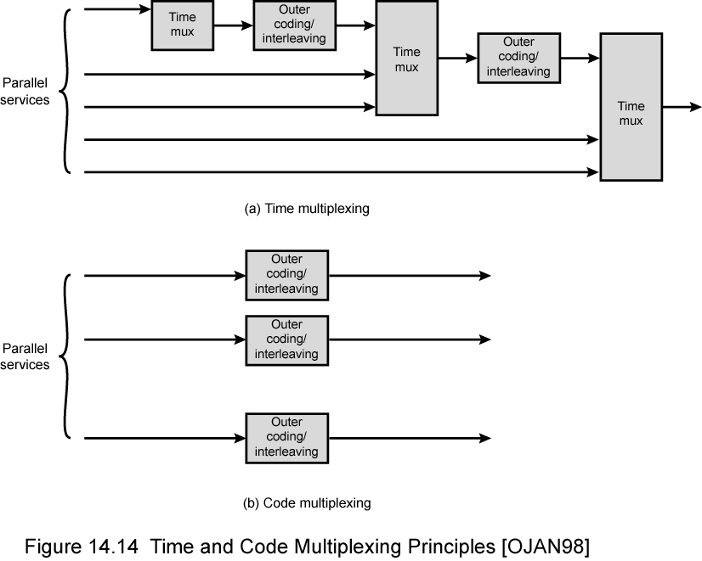
Time and Code Multiplexing

Slide 64
Required Reading
Stallings chapter 14
Web search on 3G mobile phones

